Slide 1
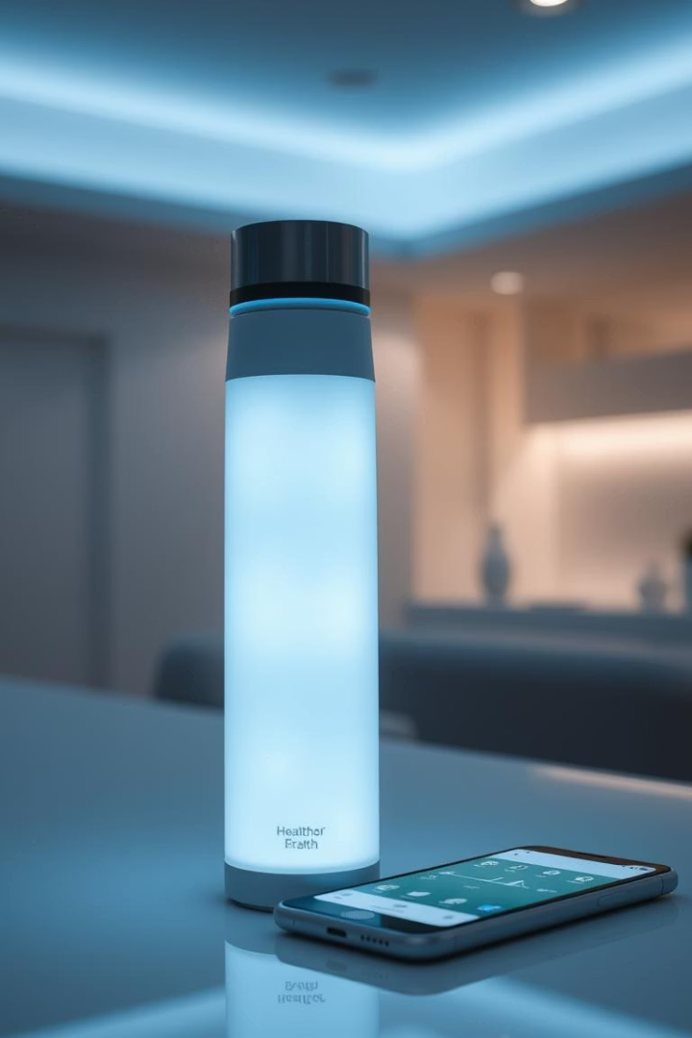

HydraMate: Smart Hydration, Smarter Living
HydraMate is an intelligent water bottle that optimizes your hydration. It provides personalized hydration tracking and reminders. Our goal is to prevent dehydration, enhancing performance and overall well-being.
by Vidyasri Dolai

Slide 2

The Problem: Chronic Dehydration
A significant portion of the population is chronically dehydrated, impacting daily function. This widespread issue leads to fatigue, headaches, and reduced cognitive abilities.
75% of Americans are chronically dehydrated (CDC, 2023).
Costs US healthcare system $20B annually (Harvard Study, 2022).
Existing hydration solutions are often inadequate, lacking the necessary personalization. They fail to address individual needs effectively.

Slide 3
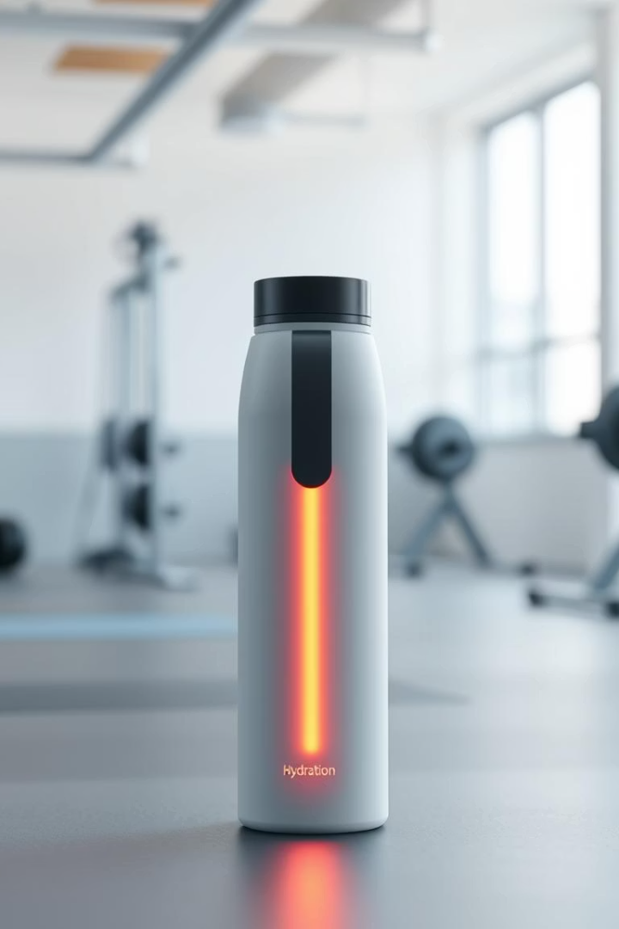




Our Solution: HydraMate - The Smart Bottle
Real-time Tracking
Smart Reminders
Personalized Goals
Integrated sensors provide immediate hydration data.
Mobile app delivers timely drinking prompts.
Hydration goals adjust to activity, environment, and physiology.
Premium Design
Leak-proof, BPA-free, and dishwasher-safe for convenience.
HydraMate tracks water intake, temperature, and ambient humidity. It offers a comprehensive solution for personalized hydration needs.

Slide 4





Product Overview: Features & Functionality
Smart Sensors
Mobile App
Connectivity
Ultrasound + capacitive sensors offer ±5% accuracy for precise tracking.
Available on iOS & Android, providing data tracking and personalized insights.
Bluetooth 5.0 ensures reliable connection with a 300ft range.
Battery Life
Materials
Long-lasting 7-day battery with convenient USB-C charging.
Made from Tritan Renew (50% recycled content), promoting sustainability.
HydraMate's advanced features ensure an intuitive and effective user experience. Its robust design combines technology with sustainability.

Slide 5
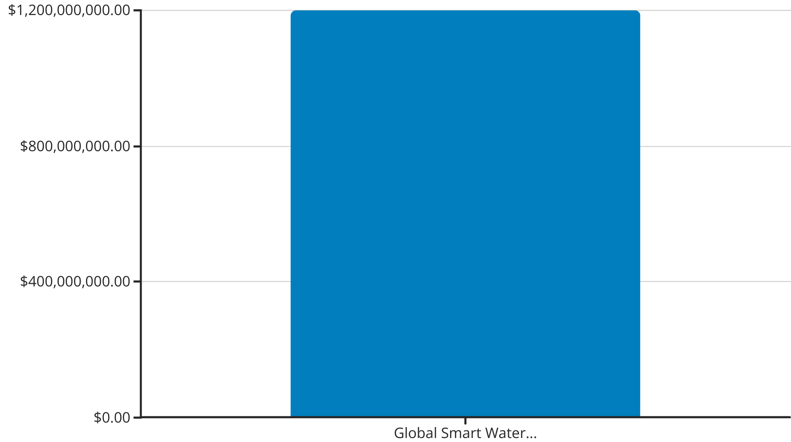
Market Opportunity: Exploding Health & Wellness
The global smart water bottle market is projected to reach $1.2B by 2025. HydraMate targets fitness enthusiasts, athletes, and health-conscious individuals. Our focus on personalized, data-driven hydration sets us apart. A survey shows 65% of athletes would pay a premium for smart hydration tracking.

Slide 6



Business Model: Premium Product + Subscription
Subscription Value
1
$4.99/month for advanced analytics and coaching.
Bottle Sales
2
HydraMate Bottle sells for $69.99 MSRP.
Low COGS
3
$25 per bottle ensures strong margins.
Our revenue streams include bottle sales and HydraMate Pro subscriptions. We project a customer acquisition cost (CAC) of $10. Our marketing strategy involves digital campaigns, influencer partnerships, and athletic sponsorships.

Slide 7



Our Team: Experts in Hydration, Hardware & Software
CEO, [Name]
Ex-Nike product manager with 10+ years of experience.
CTO, [Name]
MIT-trained engineer specializing in sensor technology.
Advisor, Dr. [Name]
Leading sports medicine physician and dehydration expert.
Our core team consists of seven experienced professionals. They bring expertise from Fitbit, Apple, and Gatorade. This diverse talent pool drives innovation and excellence at HydraMate.

Slide 8

Financial Projections & Call to Action
$500K
$1M
Seed Round Ask
Projected Revenue (Year 1)
For scaling production and marketing efforts.
From 14,300 bottle sales plus subscription revenue.
60%
Gross Margin
Strong profitability on our product sales.
Join us in revolutionizing hydration and building a healthier future. We are seeking $500,000 in seed funding. Our projections indicate strong initial revenue and gross margin. Contact us to learn more.

Slide 9
THANK YOU…
VIDYASRI DOLAI

